Slide 1


Web application with database
JDBC programming

Slide 2
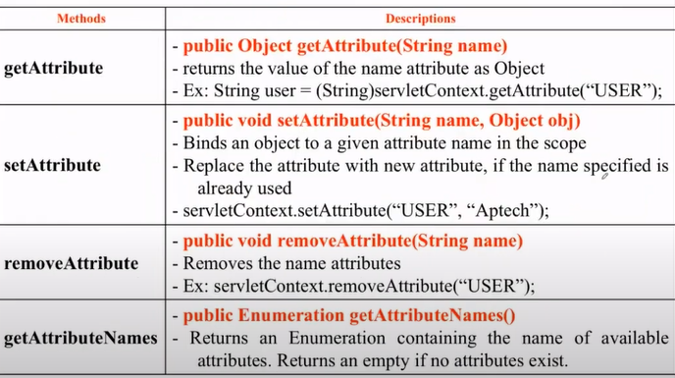
Review

Slide 3
Objectives
Relational Database Overview
JDBC and JDBC Drivers
Steps to code JDBC CRUD task.
Database connection with data source
Statements and execution
JDBC transaction management
JDBC Enhancement
Database application design

Slide 4
Database and DBMS
Database is a collection of related data which are stored in secondary mass storage and are used by some processes concurrently.
Databases are organized in some ways in order to reduce redundancies.
DBMS: Database management system is a software which manages some databases. It supports ways to users/processes for creating, updating, manipulating on databases and security mechanisms are supported also.
DBMS libraries (C/C++ codes are usually used) support APIs for user programs to manipulate databases.

Slide 5
Relational Database Overview
Common databases are designed and implemented based on relational algebra (set theory).
Relational database is one that presents information in tables with rows and columns.
A table is referred to as a relation in the sense that it is a collection of objects of the same type (rows).
A Relational Database Management System (RDBMS)- such as MS Access, MS SQL Server, Oracle- handles the way data is stored, maintained, and retrieved.

Slide 6
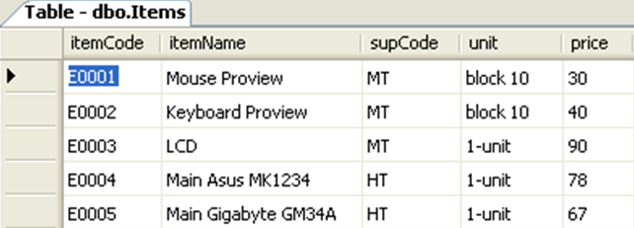

Structure Query Language (SQL)
Data Definition Language (DDL):
CREATE…/ ALTER…/ DROP…
3 languages:
Data Manipulating Language (DML):
SELECT…/ INSERT INTO … / UPDATE … / DELETE
Data Control Language (DCL):
GRANT…/ REVOKE … / DENY…

Slide 7
Structure Query Language (SQL)
Common DML queries:
  SELECT columns FROM tables WHERE condition
  UPDATE table SET column=value,… Where condition
  DELETE FROM table WHERE condition
  INSERT INTO table Values ( val1, val2,…)
  INSERT INTO table (col1, col2,…) Values ( val1, val2,…)

Slide 8
JDBC : Java Database Connectivity
JDBC is a technology standard consisting of interfaces and classes that define how a Java application connects and interacts with a database..
The JDBC API is a Java API that can access any kind of tabular data, especially data stored in a Relational Database.
  Connect to the database
  Execute queries and update database
  Retrieve the result received from the database.

Slide 9
JDBC Driver
The JDBC driver is an executable version of JDBC developed by DBMS vendors that allows Java applications to work with DBMSs.
Based on the characteristics of interaction with DBMS, there are four types of JDBC drivers
  Type 1: JDBC ODBC Bridge
  Type 2: Native API
  Type 3: Open Network Protocol
  Type 4: Native Protocol
  Type 1 and Type 4 are populated.

Slide 10
Type 2-Driver: Native API
Provides access to the database through C/C++ codes.
Developed using native code libraries
Native code libraries provide access to the database, and improve the performance
Java application sends a request for database connectivity as a normal JDBC call to the Native API driver
Establishes the call, and translates the call to the particular database protocol that is forwarded to the database
Application
Java Application
Type II JDBC Driver
SQL Command
Result Set
Native Database Library
Proprietary Protocol
Database

Slide 11
Type 3: Open Network Protocol
Application
Use a pure Java client and communicate with a middleware server using a database-independent protocol.
The middleware server then communicates the client’s requests to the data source
Manages multiple Java applications connecting to different databases
Java Application
Type III JDBC Driver
Result Set
Middleware
JDBC
Database

Slide 12
Type 4-Driver: Native Protocol
Application
Communicates directly with the database using Java sockets
Improves the performance as translation is not required
Converts JDBC queries into native calls used by the particular RDBMS
The driver library is required when it is used and attached with the deployed application (sqlserver 2000: mssqlserver.jar, msutil.jar, msbase.jar; sqlserver 2005: sqljdbc.jar; jtds: jtds.jar …)
Independent platform
Java Application
Type IV JDBC Driver
SQL command
Result Set
use Proprietary protocol
Database

Slide 13
Database URL
Database URL: string representing DBMS and database addresses - specified by JDBC driver.
General syntax
jdbc:subprotocol name:other_stuff
  subprotocol name: specified by the driver listed in the driver's manual.
  Other_stuff: driver dependency
Ex
Class.forName(“com.microsoft.sqlserver.jdbc.SQLServerDriver”);
String dbURL=“jdbc:sqlserver://ServerName:Port;databaseName=FuLib”;
String user =“dbuserName”, pw=“xxxx”;
Connection con= DriverManager.getConnection(dbURL,user, pw);
Database URL
Notes:
integratedSecurity=true

Slide 14
General introduction..
6 steps for JDBC database programming
  Load JDBC driver
  Create connection with database - DBMS
  Generate SQL statement to perform desired task
  Execute SQL statement
  Processing execution results
  Close connection
JDBC Driver can config to load by web server or application server.

Slide 15
Loading Driver
DriverManager is a class that manages JDBC drivers and creates connections with DBMS
Class.forName(String);
  Class.forName(“sun.jdbc.odbc.JdbcOdbcDriver”);
  Equivalent to:
  new sun.jdbc.odbc.JdbcOdbcDriver();
  or
  DriverManager.registerDriver(new sun.jdbc.odbc.JdbcOdbcDriver());
Can load multiple drivers simultaneously to interact with multiple DBMS
Using Data Source without the need of loading driver

Slide 16
Make a connection
Depending on the DBMS the connection requires user authentication
  DriverManager.getConnection(dbURL, user, password)
  DriverManager.getConnection(dbURL)
Connections to DBMS server is limited resources
  Open connection when needed.
  Close the connection immediately after finishing the task
Auto-close connection – use “try with resource” to prevent leakage of connection resources (Java 8)
  try(Connection con=DriverManager.getConnection(…)){…}..
Connection Pool is a multi-user solution for database applications with large user loads.

Slide 17
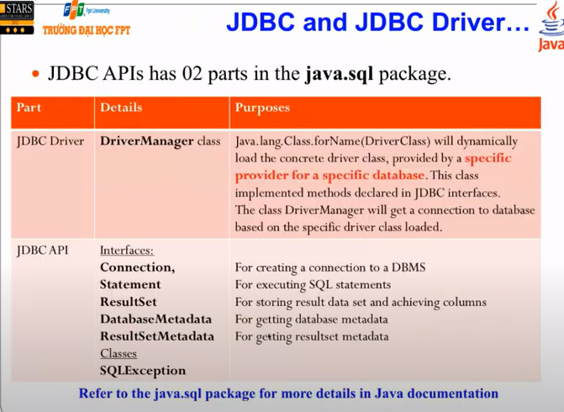


Slide 18
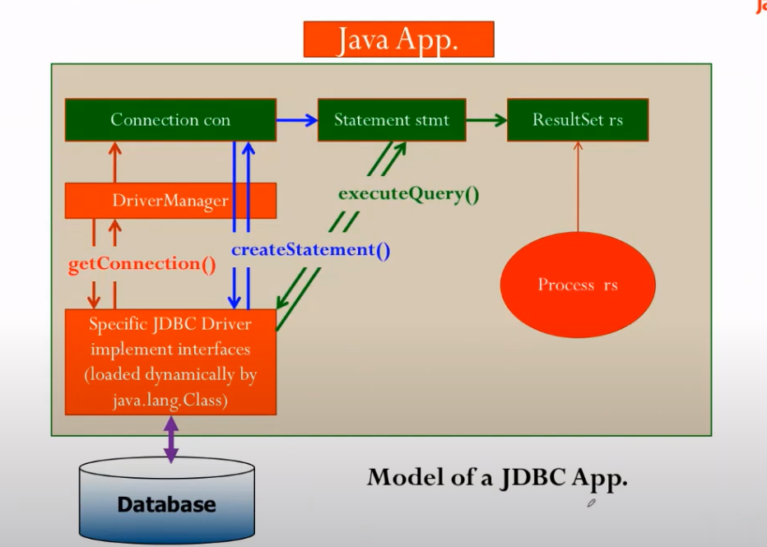

Slide 19
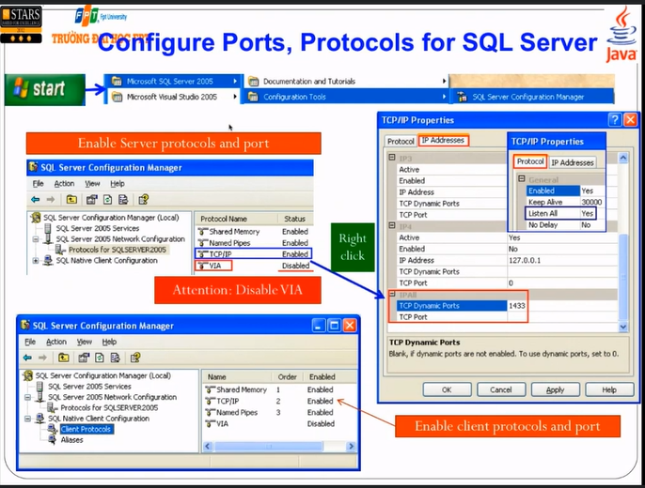

Slide 20
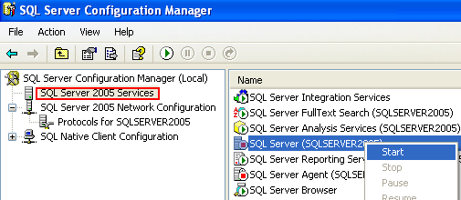
Configure Ports, Protocols for SQL Server…
Stop then restart SQL Server and SQL Server Agent for settings are affected.
Right
click

Slide 21
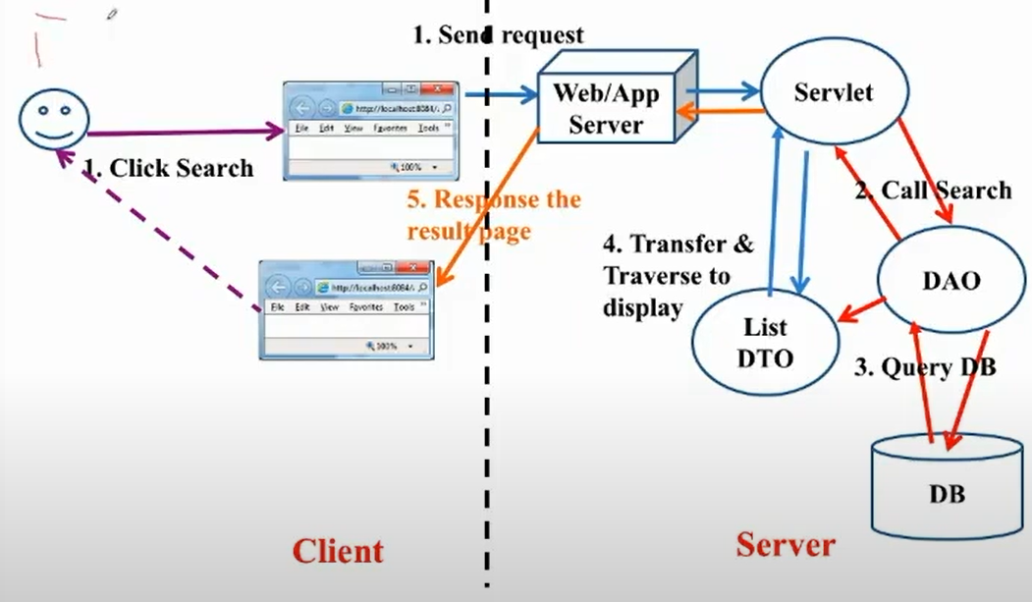
Review MVC

Slide 22
Step 3: Create &Execute a SQL statement
String sql1 = “SELECT columns FROM table1, table2, … WHERE condition”;
String sql2 = “UPDATE table SET column = value, … WHERE condition”;
String sql3 = “INSERT INTO table VALUES ( val1, val2, … )” ;
String sql4 = “INSERT INTO table (col1, col2, col3) VALUES ( val1, val2, val3)” ;
String sql5 = “UPDATE table SET col1 = ?, col2=? WHERE condition”;
// Connection con was created
Statement stmt= con.createStatement();
ResultSet rs= stmt.executeQuery(sql1);
int numOfInfectedRows = stmt.executeUpdate(sql2);
int numOfInfectedRows = stmt.executeUpdate(sql3);
int numOfInfectedRows = stmt.executeUpdate(sql4);
PreparedStatement pStmt = con.preparedStatement(sql5);
pStmt.setXXX (index, val); // from 1
int numOfInfectedRows = pStmt.executeUpdate(); // no argument
Notes:
Ex: SELECT * FROM [User] where UserName like 'sa%'or 1=1(Injection SQL)

Slide 23
Step 4: Process the results
BOF
Move the current row:
boolean next(), previous(), first(), last()
Default: Result set moves forward only.
Record 1
Record 2
Get data in columns of the current row:
TYPE getTYPE ( int columnIndex) // begin from 1
TYPE getTYPE ( String columnLabel)
Record 3
…..
…..
…..
SELECT desc AS description FROM T_employee
Column name: desc
Column Label: description
EOF
ResultSet
At a time, resultset maintains a current position. When the resultset is initialized, the position is the BOF position. An exception is thrown when the current position is out of its scope.

Slide 24
Step 5: Close the connection
Opening Order:
Connection
Statement
ResultSet
Closing Order:
ResultSet
Statement
Connection
Attention!!!
At a time, a connection can be bound with ONLY ONE result set.
An exception will be thrown if we try binding a connection with another result set.
EX:
String sql1 =“SELECT…”;
String sql2 =“SELECT…”;
ResultSet rs1= stmt.executeQuery(sql1);
ResultSet rs2= stmt.executeQuery(sql2); ➔ EXCEPTION
You should close the rs1 before trying get the rs2 result set
Solution: Transfer data in the rs1 to ArrayList (or Vector) then close rs1 before get new data to rs2.

Slide 25
Statement
Three types of Statement
  Statement: execute arbitrary statements at run time
  PreparedStatement : precompiled SQL statement
  CallableStatement: call procedure on DBMS
Use the connection to create the statement
  Statement s = con.createStatement();
  PreparedStatement ps= con.prepareStatement(String);
  CallableStatement cs= con.prepareCall(String);
The Statement can be used many times for different tasks, for any SQL
Statement <- PreparedStatement <- CallableStatement

Slide 26
PreparedStatement
Use PreparedStatement to increase SQL statement execution efficiency
  The SQL statement will be compiled once before being called to execute multiple times.
  Change the argument each time it's executed.
PreparedStatement updateAddr = con.prepareStatement(
"UPDATE Customers SET Address = ? WHERE CustNo= ?");
updateAddr.setString(1, “Danang”);
updateSales.setInt(2,1001);
After setting the argument values, they are preserved until a new value is set or a method is called clearParameters() to clear the value of arguments

Slide 27
Execution of Statement
There are 3 ways of Statement execution.
  executeQuery()
  executeUpdate()
  execute()
executeQuery()
  used to execute queries
  Select.. from ..where
  Returns the query results via the ResultSet object.
  ResultSet rs = s.executeQuery(“SELECT * FROM Books”);

Slide 28
Execute Statement..
executeUpdate()
  used for the update data statement,
  Returns the number of records affected by the UPDATE, INSERT, or DELETE statement.
  returns 0 , which means:
    (1) no records are affected
    (2) execute the data definition DDL statement.
execute()
  when it is not clear whether the statement is a query or an update.
  used for dynamic SQL execution cases.,
  returns true if the statement is a query.
    call getResultSet() to get query result
    call getUpdatedCount() to get the number of records updated.

Slide 29
ResultSet
ResultSet allows access to data returned from database query results.
  Retrieve each field of the record with a pointer to the current position in the ResultSet
  Call next( ) to move the current cursor to the next row of the ResultSet.
    next() returns true means there is data to read, otherwise: no more row
  use the following loop structure to traverse a ResultSet
  while (rs.next()){
  // manipulate row by row and column by column – forward only
  }

Slide 30
Handling ResultSet..
The data at each field of the record is read by method getType() :
  type getType(int | String)
    argument is column order – starting from 1- or column name
    type of Type can be int, double, String, Date, .. arbitrary
  String isbn = rs.getString(1); // Column 1
  float price = rs.getDouble(“Price”);
Note
  ResultSet associated with connection to database
  Forward only by default
  Automatic type conversion by JDBC driver

Slide 31
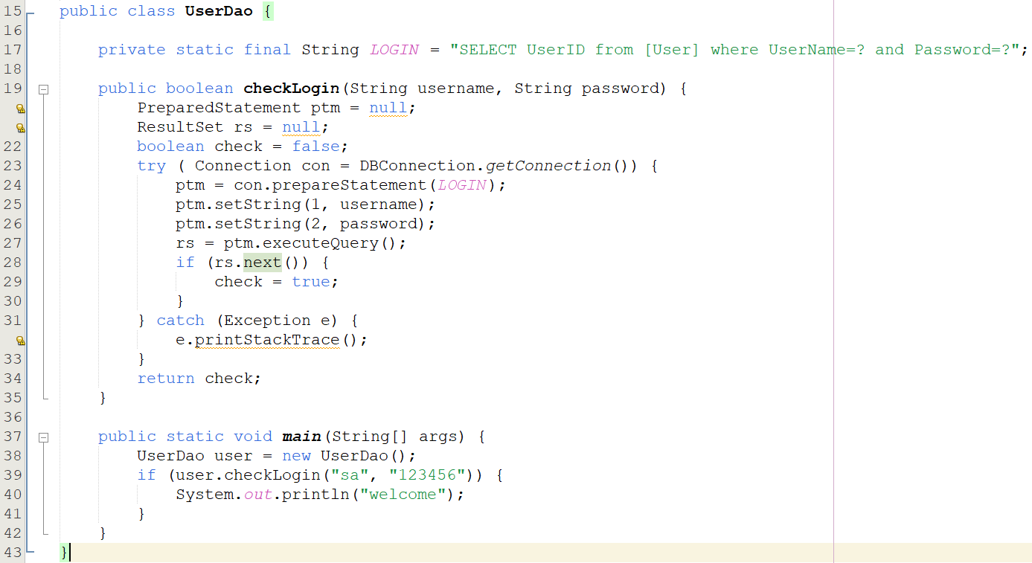

Slide 32
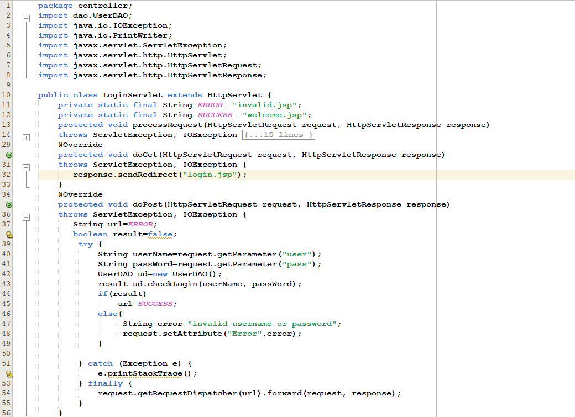

Slide 33
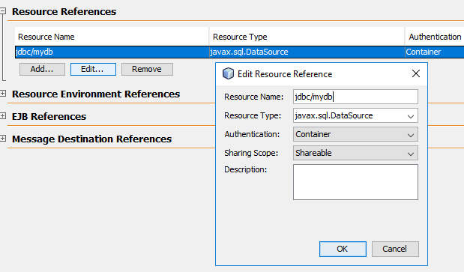
Make connection from DataSource
Declare data resource reference in web.xml

Slide 34
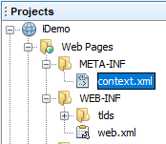
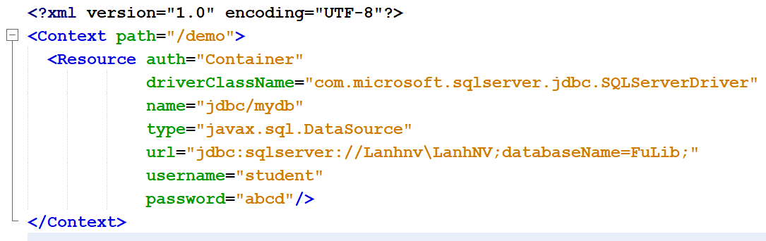
Make connection from DataSource
For web application, connection can create from Data Source without loading driver when coding JDBC
Declare Data source in Context.xml

Slide 35
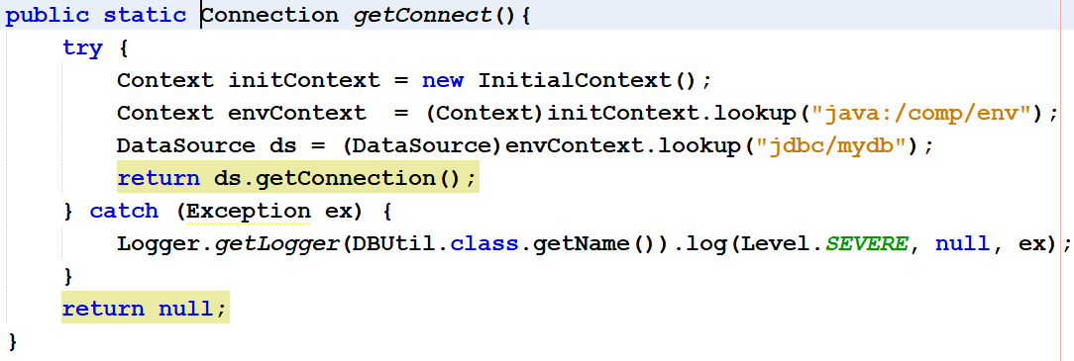
Make connection from DataSource
Static method to create connection from data source

Slide 36
Callable Statement
CallableStatement provides a call to execute pre-installed procedures on the DBMS.
Syntax
  {Call procedure_name(arg1, arg2, ...)}
  {?= call procedure-name arg1,arg2, ...}
Question mark ? substitute for arguments
The arguments can be input (IN parameters), output (OUT parameters), or both (INOUT parameters).

Slide 37
CallableStatement
CallableStatement cstmt = con.prepareCall("{call proc(?, ?)}");
Pass the IN argument using the setxxx() function that inherits from PreparedStatement
Register the OUT argument before executing the procedure
  registerOutParameter(1,Types.VARCHAR);
INOUT . argument
  stmt1.setString(1,"00000");
  stmt1.registerOutParameter(1,Types.VARCHAR);
Stored procedures are not suitable in a complex distributed environment because they are tied to a particular DBMS

Slide 38
Transaction Management
Transaction: unit of work – all or nothing
By default, JDBC executes (commit) SQL statements once it is delivered to the database; called autocommit mode
Some applications are transactional in nature - requiring execution tasks either as a whole bundle or as doing nothing when error occur.
  Turn off autocommit mode to perform transaction management according to application characteristics
  The Connection class provides the setAutoCommit() method to toggle auto-commit mode on and off
  The first sql statement also starts a transaction, ends with commit() or rollback()
con.setAutoCommit(false);
s = con.createStatement(); s.executeUpdate(SQLString)
con.commit() ; or con.rollback();
Note: Transaction is happening only within 1 connection to the DBMS

Slide 39
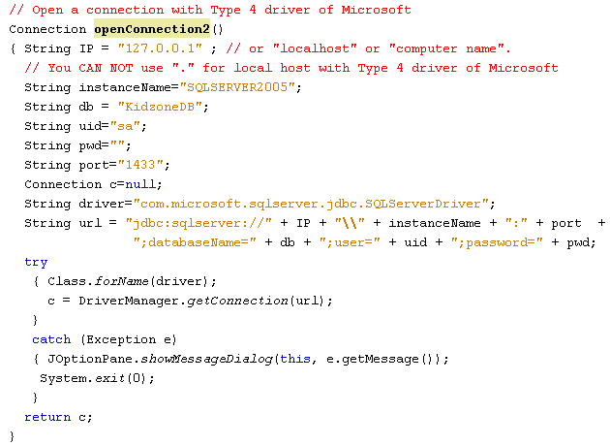
Loading JDBC Driver - Establish connection to DB

Slide 40
Create & Execute SQL statement
String sql1 = “SELECT columns FROM table1, table2, … WHERE condition”;
String sql2 = “UPDATE table SET column = value, … WHERE condition”;
String sql3 = “INSERT INTO table VALUES ( val1, val2, … )” ;
String sql4 = “INSERT INTO table (col1, col2, col3) VALUES ( val1, val2, val3)” ;
String sql5 = “UPDATE table SET col1 = ?, col2=? WHERE condition”;
// Connection con was created
Statement stmt= con.createStatement();
ResultSet rs= stmt.executeQuery(sql1);
int numOfInfectedRows = stmt.executeUpdate(sql2);
int numOfInfectedRows = stmt.executeUpdate(sql3);
int numOfInfectedRows = stmt.executeUpdate(sql4);
PreparedStatement pStmt = con.preparedStatement(sql5);
pStmt.setXXX (index, val); // from 1
int numOfInfectedRows = pStmt.executeUpdate(); // no argument

Slide 41
Process the results
BOF
Move the current row:
boolean next(), previous(), first(), last()
Default: ResultSet moves forward only.
Record 1
Record 2
Get data in columns of the current row:
TYPE getTYPE ( int columnIndex) // start from 1
TYPE getTYPE ( String columnLabel)
Record 3
…..
…..
…..
SELECT desc AS description FROM T_employee
Column name: desc
Column Label: description
EOF
ResultSet
At a time, resultset maintains a current position. When the resultset is initialized, the position is at BOF position. An exception is thrown when the current position is out of its scope.

Slide 42
Close connection - Release resource
Opening Order:
Connection
Statement
ResultSet
Closing Order:
ResultSet
Statement
Connection
Attention!!!
At a time, a connection can be bound with ONLY ONE result set.
An exception will be thrown if we try binding a connection with another result set.
EX:
String sql1 =“SELECT…”;
String sql2 =“SELECT…”;
ResultSet rs1= stmt.executeQuery(sql1);
ResultSet rs2= stmt.executeQuery(sql2); ➔ EXCEPTION
You should close the rs1 before trying get the rs2 result set
Solution: Transfer data in the rs1 to ArrayList (or Vector) then close rs1 before get new data to rs2.

Slide 43
JDBC Enhancements
Two parts
  Core Java feature enhancements. Print java.sql package
  Extended features. Print javax.sql package. Extra download
Enhancements
  Scrollable Result Sets(in core API)
  Batch Updates (in core API)
  Advanced Data Types (in core API)
  JNDI for connecting to a database (in extension API)
  Connection pooling (in extension API)
  Rowsets (an additional Result type) (print extension API)
  Distributed transaction support (in extension API)

Slide 44
Scrollable Result Sets
ResultSet: three types of result sets
  methods for moving the cursor to a particular row or to a relative position (either forward or backward)
  previous(), beforeFirst(), first(), last( ), absolute(), and relative( ).
  methods for ascertaining the current position of the cursor
  constants indicating the scrollability of a result set
Connection
  new versions of the methods for creating Statement, PreparedStatement, and CallableStatement objects that make the result sets that produce scrollable
  con.createStatement(
  ResultSet.TYPE_FORWARD_ONLY, ResultSet.CONCUR_READ_ONLY);
DatabaseMetaData
  method indicating whether the DBMS and driver support scrollable result sets

Slide 45
Batch Updates
The new batch update facility provides the ability to send multiple updates to the database to be executed as a batch rather than sending each update separately
  Statement, PreparedStatement, and CallableStatement have methods for adding update statements to a batch, clearing all update statements, and executing a batch .
Statement s = connection.createStatement();
s.addBatch(“INSERT….“);
s.addBatch(“INSERT….“);
s.executeBatch();
  can queue up SQL and execute in one call, improving efficiency
BatchUpdateException:
  throw exception when an error occurs in a batch update

Slide 46
Database application design
Multi-tier application structure allows to separate the functionality of each layer, speeding up the application development process
Creates relative independence of the business object from the data layer: changing the DBMS or database does not affect the business layer
Data Access Object (DAO) pattern is a structural pattern that isolate the application/business layer from the persistence layer using an abstract API.
Account – AccountDAO – AccountDB -> DBMS
(business obj) (interface) (implementation)

Slide 47
Practical exercise
Download and use a JDBC Driver from the internet
Develop the Account class associated with the Account table in the AllInOne.sql database follow DAO pattern.
  Pay attention to transaction management in multi-step business tasks of Account
  Combine error handling using Exception
  Using Predicate and lambda expression for searching account with different criteria

Slide 48
Summary
Introduction to databases
Relational Database Overview
JDBC and JDBC Drivers
Steps to develop a JDBC code.
Connection with data source
Statement and Execution
Transaction management
JDBC enhancement
Database application design

